Slide 1
Speaker Notes
This presentation and lab is appropriate for anyone who wants to sell their application in the Teams app store and Microsoft App Source
This deck is part of “App Camp in a Box”, a set of material to accompany the App Camp labs in an in-person workshop.
Instructors are strongly encouraged to watch the App Camp videos and complete the labs before delivering or proctoring App Camp! https://aka.ms/app-camp
Instruct your students to do the labs at that same location – https://aka.ms/app-camp
⬇️ Don’t forget to check the speaker notes! ⬇️

Slide 2


Monetize your Teams Application (Extended lab)

Slide 3

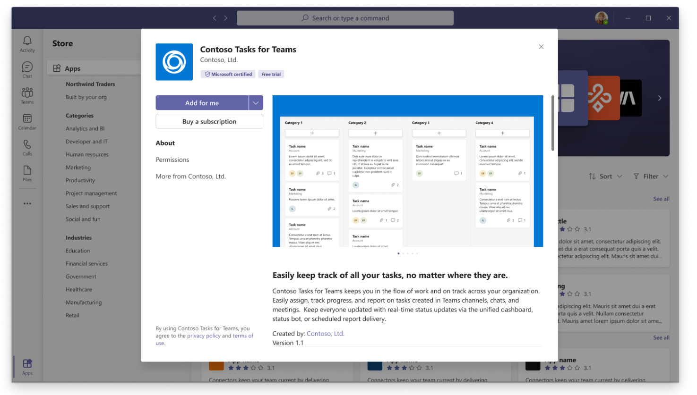
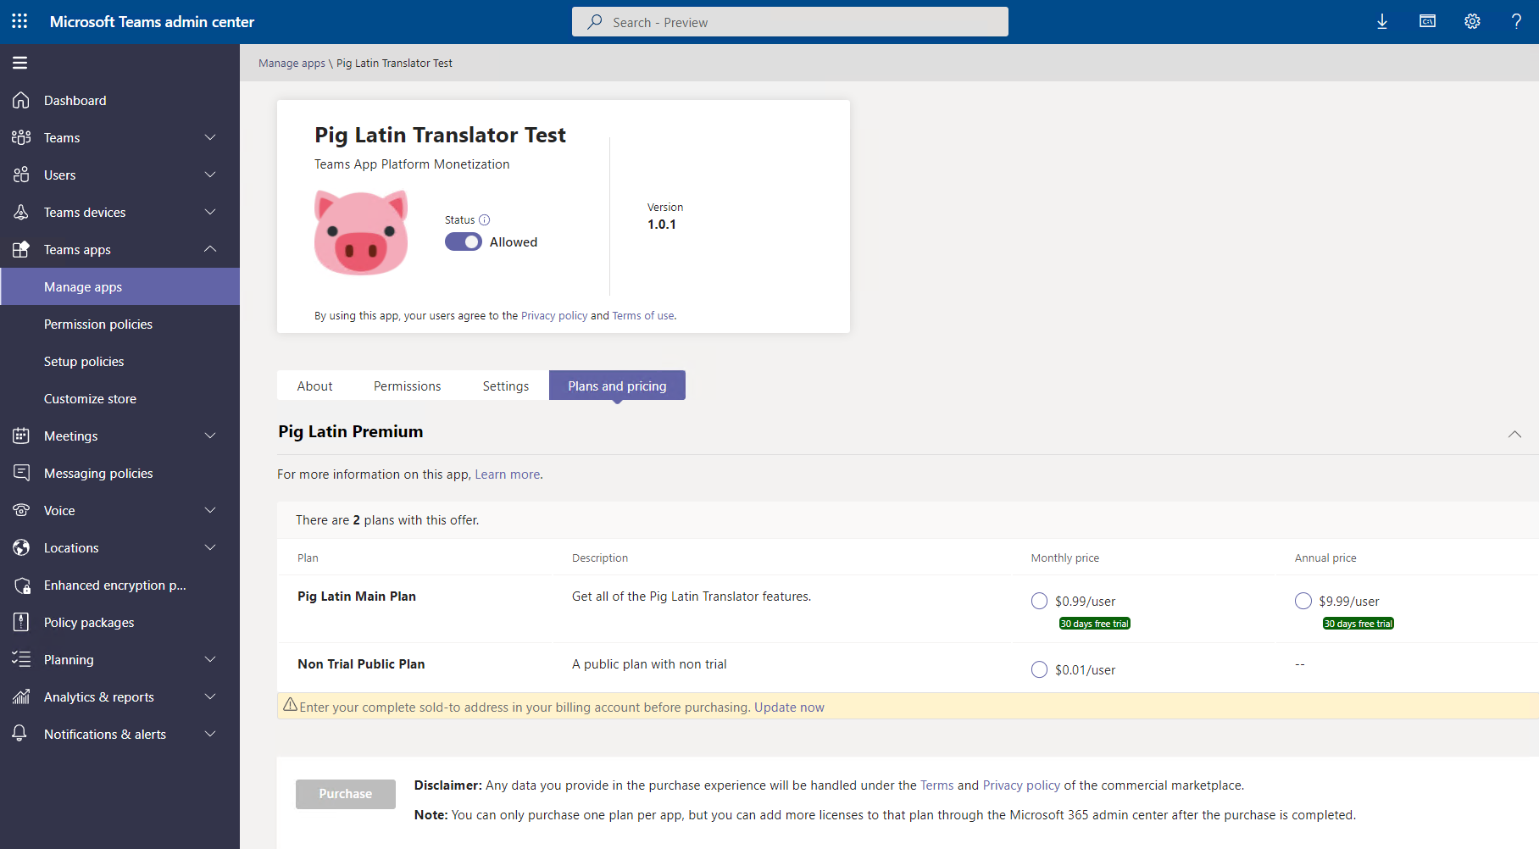

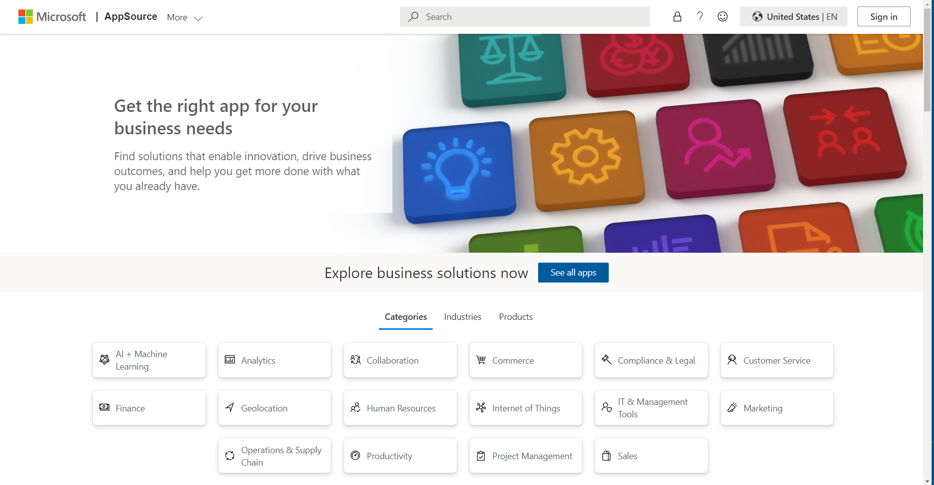
How can users buy your app?
Teams App Store purchase via credit card
Teams Admin Center purchase via credit card or invoice billing
Microsoft App Source via credit card or invoice billing
Notes:
Customers can buy a subscription to your app in the Teams app store, in Teams administration center, or in Microsoft App Source. They can pay via credit card or invoice billing. In addition, Microsoft partners in the Cloud Solution Providers can sell your app to customers as part of their services.

Slide 4

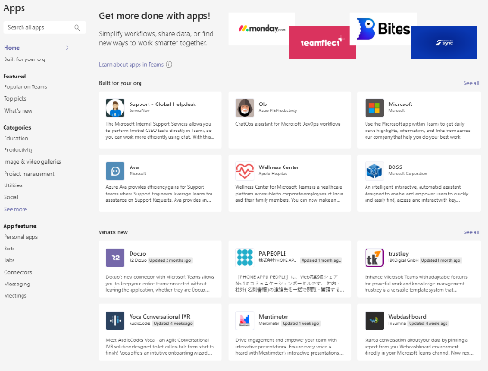
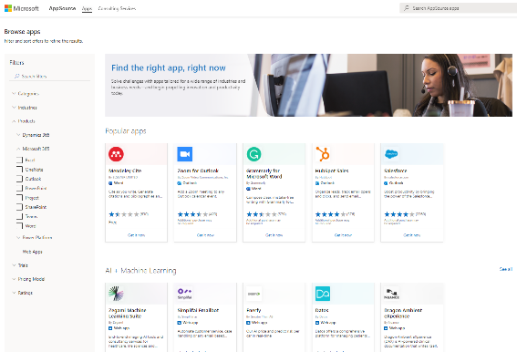
Monetizing your app in the Teams App Store
Teams application
Transactable SaaS offer
(Teams App Store)
(AppSource web app)
Notes:
A monetized Teams application is a Teams application that’s linked to a “transactable SaaS offer”, which is the thing you’re selling to customers.
To make the linkage, the transactable SaaS offer has a reference to the Teams app ID, and the Teams app’s manifest has a reference to your offer ID in Partner Center.
There are videos on the App Camp site that go into a lot more detail.

Slide 5
Who does what?
Microsoft
ISV
List SaaS offer(s) in Teams Store and Microsoft AppSource
Facilitates transactions with customer where they choose a plan and # of users and collects billing information
Transacts the purchase by charging customers and sends money to ISVs based on payment schedule
Maintain information about offers, plans, etc. in Partner Center for display by Microsoft
When a subscription is purchased, make your services available to the customer via your published webhook and landing page
Handle all aspects of license assignment and enforcement
Notes:
First, you enter data about your SaaS offer(s) in Partner Center.
When this is set up and a Teams app is validated for the app store and linked, Microsoft lists the app in the Teams store and Microsoft App Source.
Then Microsoft facilitates the purchase of subscriptions and sends you the proceeds.
Your app needs to enforce licensing for the subscriptions purchased, and it needs to support - a landing page where customers are directed upon purchasing a subscription
- web hooks to get updates should a customer change their subscription, etc.

Slide 6
Commercial Marketplace API and Webhooks
SaaS fulfillment API v2:
- Resolve a subscription (send marketplace token, get subscription details) *
Activate a subscription *
Cancel a subscription *
- Get list of all subscriptions
- Get subscription
- List available plans
- Change the plan on the subscription
- Change the quantity of seats on the SaaS subscription
Webhooks (SaaS subscription is in Subscribed status):
- ChangePlan *
- ChangeQuantity *
- Renew
- Suspend
- Unsubscribe *
Webhooks (SaaS subscription is in Suspended status):
- Reinstate
- Unsubscribe
* Implemented in lab sample
Notes:
Your app can call the marketplace SaaS fulfillment API to handle subscription management tasks; the lab uses a simulator that mimics some of these API calls
The marketplace can contact your app via web hooks; the lab sample code implements some of these API calls

Slide 7
Testing the Teams app monetization sample
Hosted as Azure App Services
App Source Mock
Simulate purchasing a subscription
Calls SaaS web hooks with subscription updates
Emulates portions of commercial marketplace API
Tracks Microsoft’s view of subscriptions in SQL database
Your (SaaS) Web App
Your Teams Application
Implements a landing page for your application
Implements simple license management screens for your application
Your (SaaS) Web API
Implements SaaS webhooks for subscription updates
Provides a call to check a user license
Provides back-end for SaaS Web App
Tracks your app’s view of subscriptions and licenses in SQL database
Notes:
The app source and marketplace API simulator is shown in green in this picture
Code that an ISV would write is shown in purple; this includes a web application that implements a landing page and a web API that implements the web hooks.
You will inspect this code and integrate it with your Teams application.

Slide 8

demo
Notes:
Lab demonstration:
- Go to the App Source simulator used in the lab and cancel your subscription
- Return to any tab in the Teams app and hit refreh; you should get a licensing error - Go to the App Source simulator and purchase a license. When you switch from a green to a light blue background, your have left the App Source simulator (or Teams app store) and arrived at the ISV’s landing page Configure the licensing to auto-provision licenses, as explained in the lab instructions
- Refresh the Teams app and see that it works - Refresh the licensing page and notice your username has been granted one license
- A special token is passed to the landing page. Show the ResolveAsync() web method that interprets this token at https://github.com/OfficeDev/office-add-in-saas-monetization-sample/blob/7673db6c8e6c809ae7aa0ba894460183aed964fc/MonetizationCodeSample/SaaSSampleWebApi/Controllers/SubscriptionsController.cs#L134 . Point out all the information the app gets when a subscription is purchased.

Slide 9
LAB TIME https://aka.ms/app-camp Monetization Lab
Notes:
Note there is a video for each lab showing a complete walk-through

Slide 10



Lab Structure
Core Lab (path A)
App setup
Add tab with SSO
Add look and feel
Migrate an Azure AD Web App to Teams
start
Personal tab with
Azure AD SSO
Core Teams Application
Configurable
tab
Deeplinks
Dialog
Message Extension w/Adaptive Cards
Monetization
Extend capabilities
Notes:
ASK ONE OF THE PARTICIPANTS TO DEMO THE APP

